Slide 1


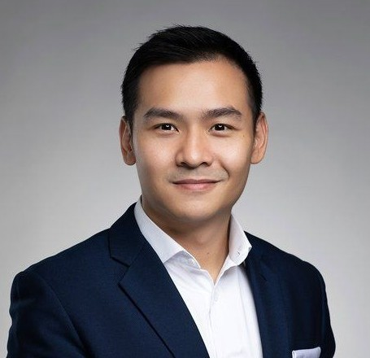

Determinants of Effective Teaching and Learning in Malaysian Polytechnics:
A Conceptual Model
(VE765)
HOW TO INSERT PICTURE
Right-click the picture
Format Picture
Fill & Line
Picture or texture fill
Insert picture source
INSERT YOUR PHOTO HERE
MOHD HARIS BIN SULAIMAN
Jabatan Kejuruteraan Awam
Politeknik Kota Bharu

Slide 2


Slide 5

tammat

